Slide 1


CYBR644 – Cyber Practitioner Lab
Spring 2024
University of Maryland, Baltimore County
Michael Hennick

Slide 2
Overview of the course
Week 01 – Introduction, Ethical Hacking Basics, Ethics, Law
Week 02 – Technical Foundations of Hacking
Week 03 – Reconnaissance, Social Media
Week 04 – Scanning and Probing
Week 05 – Vulnerability Identification
Week 06 – Exploiting Weaknesses
Week 07 – Class Presentations / Review for Exam
Week 08 – Spring Break
Week 09 – Midterm Exam
Week 10 – Privilege Escalation, Maintaining Access
Week 11 – Malware, Covering your Tracks
Week 12 – The Web
Week 13 – Wireless and Mobile Security
Week 14 – Physical Security, Social Engineering, and Security Policies
Week 15 – Class Presentations / Review for Exam
Week 16 – Final Exam

Slide 3
Project 2
Two options
Option 1:
Perform research on an information security (cyber security) tool. This could be a deeper dive on the tools we've discussed in class, or you can present on a tool we haven't used/discussed. Whatever tool you choose, please answer the following areas:
1. Background on the tool, such as developer and whether it is "active" as far as being developed and updated.
2. Tool's usage, including a couple use cases on why you would select the tool during a penetration test, or in responding to an incident.
3. Screenshots or demonstration of the tool in use.
4. Comparison of the tool with other's that do similar functions.
Option 2:
Perform a penetration test against all four of the Victim VMs. As you perform the penetration test, be sure to outline the discovery of the systems, what services were found, the vulnerabilities found, and the exploits used. Be sure to also include remediations and recommendations for the vulnerabilities and exploits that you document.
For the report, you can follow a template from Offensive Security (https://www.offensive-security.com/reports/sample-penetration-testing-report.pdf ) or from SANS (https://www.sans.org/reading-room/whitepapers/testing/writing-penetration-testing-report-33343 ), or a combination of the two.

Slide 4
Attack methodology…
6. Hide/Cover Tracks
1. Reconnaissance
5. Gain Foothold
2. Network Discovery
4. Compromise Targets
2. Host/Port Discovery
3. Vulnerability Identification
3.Application Identification

Slide 5



Beyond the fundamentals
Website Security Testing
Wireless Security Testing
Mobile Device Security Testing

Slide 6

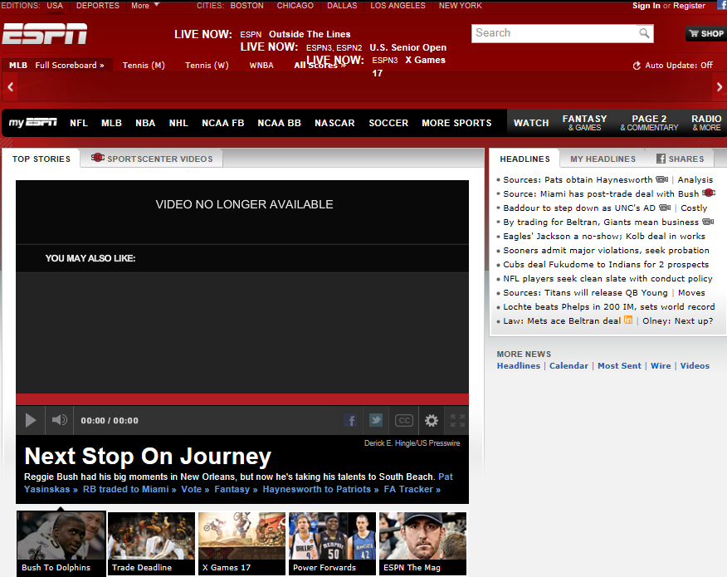
The Web
Increased usage of “the web” and “cloud computing” throughout our daily lives
Originally websites were “static”
Today’s websites are significantly more complex and “dynamic”

Slide 7
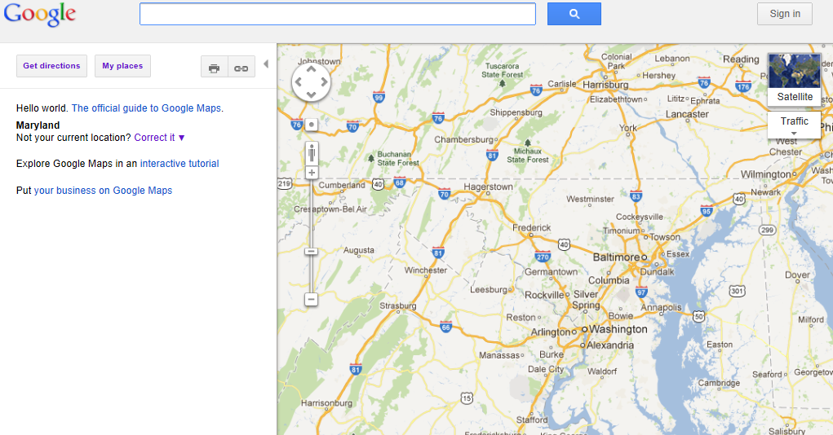
Web 2.0
Websites are doing more without us knowing it
HTTP requests made without our interactions
Mash-Ups combine various applications
AJAX (Asynchronous JavaScript and XML) and other technologies allow sites to make requests
Users are becoming “trained” to expect this type of behavior from web clients

Slide 8
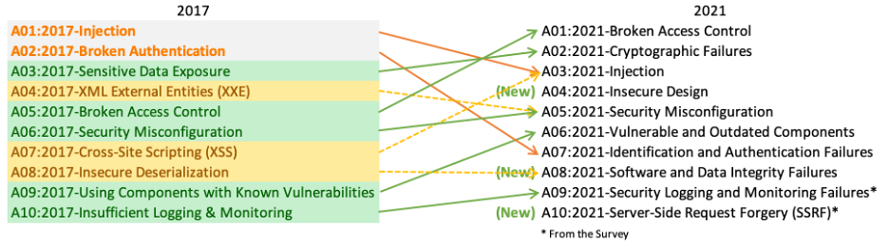
OWASP
Open Web Application Security Project
Top 10 – standard awareness document for developers and web application security to represent a broad consensus of the most critical security risks to web applications

Slide 9
HTTP Protocol
Request/Response protocol using reliable transport (typically TCP)
HTTP 1.1 is defined in RFC 2616
REQUEST
GET /search HTTP/1.1
Accept: */*
Accept-Language: en-us
User-Agent: Mozilla/4.0 (compatible; MSIE 7.0; Windows NT 5.1; .NET CLR 1.1.4322; .NET CLR 2.0.50727
Host: www.google.com
Proxy-Connection: Keep-Alive
Cookie: PREF=ID=6aa36b28984f:TM=2390049:LM=209329920:GM=1:S=CZy480sdfnmf4322
Content-length: 0
GET Method
User-Agent String
Host
Cookie
Payload

Slide 10
HTTP Protocol
Request/Response protocol using reliable transport (typically TCP)
HTTP 1.1 is defined in RFC 2616
RESPONSE
HTTP/1.1 200 OK
Content-Type: text/html;
Charset=UTF-8
Server: Apache/2.2.3 (Red Hat)
Date: Monday, 02, Jan 2012 10:01:03 GMT
Content-length: 6243
Status Code
Server Token
Server Time
Content-length

Slide 11
Uniform Resource Indicators
URI is the address of a resource including how to retrieve it
URL (Uniform Resource Locator) is used interchangeably
URI contains:
Protocol://[user:password@]host.domainname[:port]/resource?parameter=value
http://www.google.com/search?q=hacking
https://www.amazon.com/s/ref=nb_sb_noss?url=search-alias%3Daps&field-keywords=ceh
https://www.papajohns.com/papa-track?orderType=DELIVERY&storeId=711&orderId=698972312&subId=b721aca6436e983a5f9759a8563c917f687640d6

Slide 12
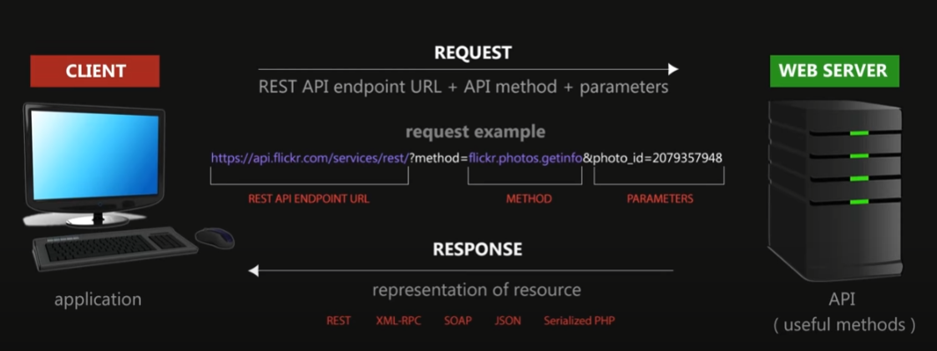
Application Programming Interfaces (API)
Web Applications for other applications to interact with as opposed to human clicking and filling out form fields
For More Information on REST APIs, Check out “Clever Techie’s” Youtube Video: https://www.youtube.com/watch?app=desktop&v=LooL6_chvN4

Slide 13
HTTP Response Codes
Numeric Code to identify the response type
1xx – Informational
2xx – Success
3xx – Redirection
4xx – Client Error
5xx – Server Error
200 – OK
302 – Redirect
401 – Unauthorized
500 – Server Error

Slide 14
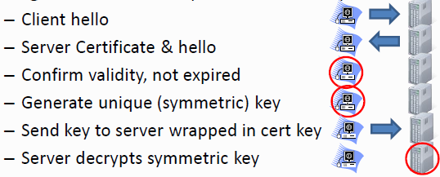
HTTPS (SSL/TLS)
SSL/TLS are two common options for encrypting HTTP
TLS is the successor to SSL
TLS Used interchangeably with SSL
Secures the transport of requests and responses as the move across the network
Relies on the trust placed with a Certifying Authority (CA)

Slide 15
Web servers
Pure Web (rarely seen today)
Static Content only
Very useful for information discovery
Typically safe from most active web application attacks
Hybrid (most common)
Both static and active content
Active content often drawn from a back-end data source (SQL database, file server, mainframe)
Simple and inexpensive to set up
More difficult to protect and harden

Slide 16
Web servers
Application Server
Web applications run within a server based application
IBM Websphere, BEA WebLogic, JBOSS, etc
Application server communicates to web server, who in turn communicates with web client
Proxy Server
Go between for a web client to speak to a web server
Can cache static components of a web application for faster delivery
Can be targets for cache poisoning and information disclosure attacks

Slide 17
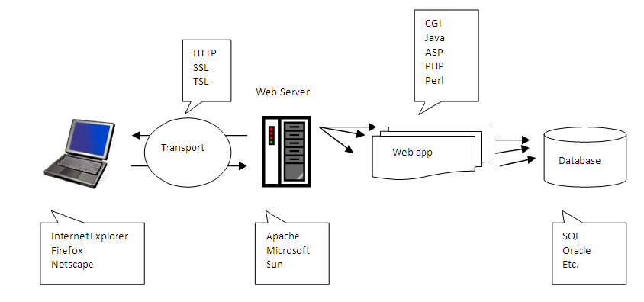
Web Server Hacking
Figure 8.1 Web Infrastructure

Slide 18
Banner Grabbing and Enumeration
Attacker tried to get additional information about the servers and components.
Popular web servers:
IIS web server
Apache web server
Sun ONE web server
Tools for enumeration and banner grabbing:
Netcraft
Telnet
Netcat
Wikto
Black Widow
Teleport Pro
Wget

Slide 19
Web Server Vulnerability Identification
Perform this step after the vendor and version of the web server is identified.
Check sites that list known vulnerabilities:
www.securityfocus.com
www.packetstormsecurity.org
http://nvd.nist.gov
http://neworder.box.sk

Slide 20
Attacks Against Web Servers
IIS Vulnerabilities:
Buffer overflow attacks:
ISAPI DLL Buffer overflow attack:
Discovered June 2001
Affects Windows NT and 2000
Targets idq.dll – runs as system and the attacker can escalate and add himself to the Administrator group
IPP Printer Overflow attack:
Discovered 2001
Affects Windows 2000 running IIS 5.0
Metaspoil can be used to launch buffer overflow attacks
Source disclosure attacks:
Can be used to uncover passwords, web design, or business logic
+.htr exploit
File system traversal attacks:
Unicode input validation attack

Slide 21
Securing IIS
Harden before deploying.
Patch management:
Use automated patch management tools:
Windows Server Update Services
Microsoft HotFix Checker
GFI LANguard
Disable unneeded services:
Microsoft Baseline Security Analyzer
IIS Lockdown
SOAPUI
Retina
Lock down the file system:
Use NTFS and enable file level security and encryption.
Enable logging and auditing.

Slide 22
Web Application Attacks
Invalidated input
Input from client is not validated before processing.
Parameter/form tampering
Manipulation of the parameters passed between client and web application
Injection flaws
Allows for untrusted data to be executed as valid
SQL injection
Command injection
File injection
LPAD injection
XML injection

Slide 23
Web Application Attacks cont.
Cross site scripting (XSS) and cross site request forgery (CSRF) attack
Gained popularity in recent years
Depend on input that is not properly sanitized
Hidden fields attack
The attacker can modify hidden fields following these three steps:
Save page locally and open source code.
Modify the amount and save the page.
Refresh the local HTML page and click Add to Cart.

Slide 24
Web-Based Authentication
Four common types of authentication:
Basic:
Uses exclusive ORing (XOR)
Weak form of encryption that can be compromised easily
Message digest:
Uses MD5 algorithm
Certificate-based:
Uses public key cryptography
Forms-based:
Uses cookies

Slide 25
Web-Based Password Cracking
Three basic types of password attacks:
Dictionary:
Uses a dictionary list to crack the password
Fast but successful only if a dictionary word were used as the password
Hybrid:
Uses a dictionary file but adds numbers or symbols to the dictionary words
Brute force:
Tries to crack the password by using every possible combination of characters specified by the user
Time-consuming
Password cracking tools:
WebCracker
Brutus
THC Hydra
ObiWan

Slide 26
Cookies
Store information about user preference, usernames and passwords, cart content, and so on.
Tools to view cookies:
CookieSpy
Cookie Digger

Slide 27
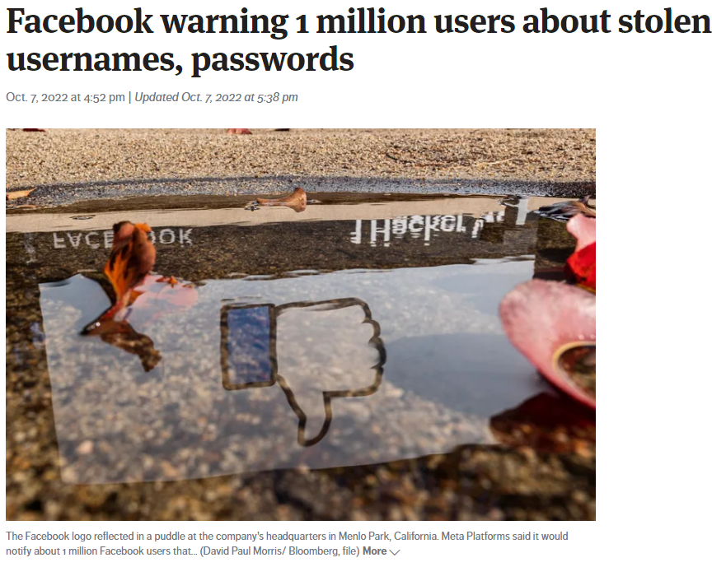
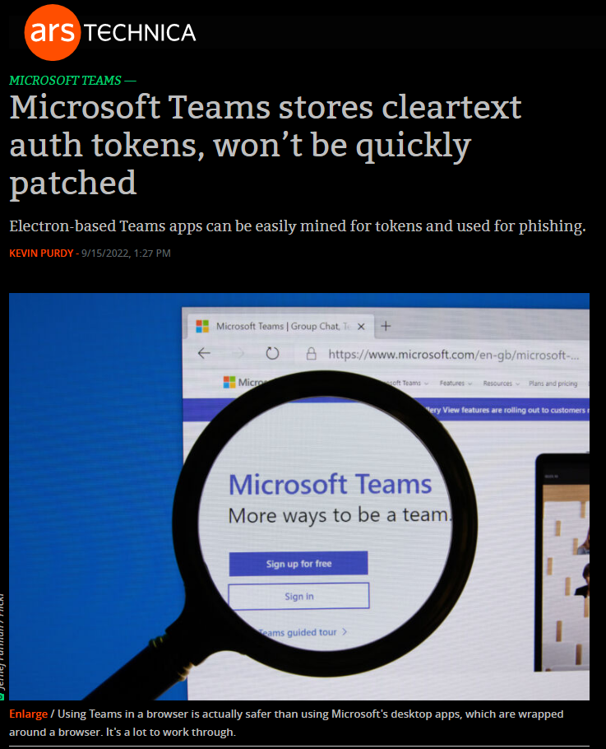
Password Breaches
https://arstechnica.com/information-technology/2022/09/microsoft-teams-stores-cleartext-auth-tokens-wont-be-quickly-patched/
https://www.seattletimes.com/business/facebook-warning-1-million-users-about-stolen-usernames-passwords/

Slide 28
URL Obfuscation
Hiding addresses in URLs to bypass filters or other defenses that block specific IP addresses
Encodes the data so it cannot be easily viewed
Common encoding schemes
Hex
HTML
Base64
Unicode

Slide 29
Intercepting Web Traffic
Web Proxies:
Allow attackers to attack and debug web applications.
Act as man-in–the–middle.
Burp Proxy
Paros Proxy
Achilles

Slide 30
Web Application scanning
Web app vulnerability scanners are different from scanners like Nessus
Nessus uses a series of plug-ins and send traffic to a machine to determine if it is vulnerable
Web scanners interact with a website through spidering and proxies
Automated Scanners:
WebSecurify
Skipfish
GrendelScan
W3AF (Web Application Audit and Attack Framework)

Slide 31
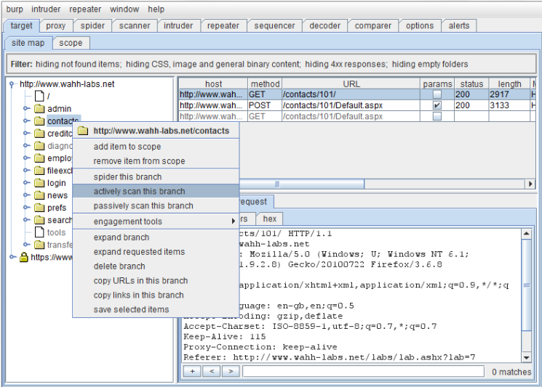
Web Application scanning
Manual Scanning with BurpSuite
Available at http://www.portswigger.net
Provides low-level access to the HTTP protocol
Two versions (Free and Professional)
Proxy (intercepts connections)
Spider (crawls)
Intruder (attack tool)
Repeater (loop interactions/attacks)
Sequencer (analyze session tokens)
Decoder (decodes)
Comparer (performs a “diff” of two pages)

Slide 32
Burp SUITE
Burp Proxy
Similar to other proxies
Proxy is the entry point for the entire tool set
Includes fine-grained rules to determine with requests/responses are intercepted
Can automatically rewrite HTML
(Used to remove client side filtering, input limits, modify user-agents, etc)
Burp Spider
Fed by the Burp Proxy
Any HTTP request sent through the proxy can be used to start the spider
Can authenticate using provided credentials
Stores pre-determined answers for forms

Slide 33
Burp Suite
Burp Intruder
Automated attack tool within the suite
Burp Repeater
Used to resubmit transactions
Use this to verify results that were found in other parts of Burp Suite
Allows us to see both the request that is sent and the response from the application
Configurable to follow redirects or not
Burp Sequencer
Used to analyze randomness of session tokens
Performs a large number of tests to determine randomness

Slide 34
Burp Suite
Burp Decoder
Able to automatically determine which encoding scheme is used in a cookie or value
Understands URL, HTML, BASE64, ASCII, octal, hex, binary, and even gzip
Can also encode data
Burp Comparer
Can “see” differences at the byte level
Commonly use this to see the results from using Intruder against a page

Slide 35
Server Side Discovery
Using Burp, we can spider a website or web application to learn about the directories and references within the application and interact with them
We can manipulate the raw HTTP requests
parameter values for “hidden” fields that aren’t designed to be exposed to end-users
User-Agent strings to see how web applications behave differently

Slide 36

Break

Slide 37
Client Side Discovery
Server Side Discovery is interacting with the web server and learning what files and pages are available to interact with.
Client Side Discovery is interacting with the client-side code that is passed to the end-user upon accessing the web application.
Takes advantage of increasing usage of client side code in applications.
AJAX (Asynchronous JavaScript and XML)
JSON (JavaScript Object Notation)
Flash

Slide 38
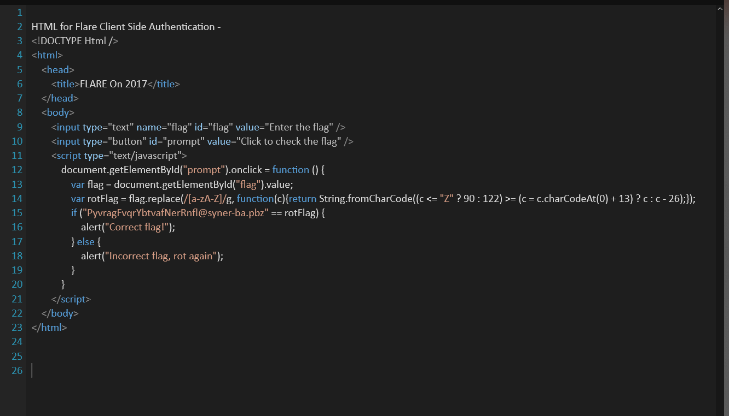
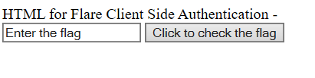
Client Side Discovery
Client Side Code can often expose business logic and/or security “features” that a web application may use.

Slide 39

Browser Exploitation Framework
Written by Wade Alcorn
Available at http://www.beefproject.com
Originally developed in PHP, recently ported to Ruby
Focuses on payload delivery
Injects attack scripts via an XSS attack using beefmagic.js.php to “hook” a browser
File connects the victim to the BeEF controller
Modules include Clipboard Stealing, History Browsing, Port Scanning, etc

Slide 40
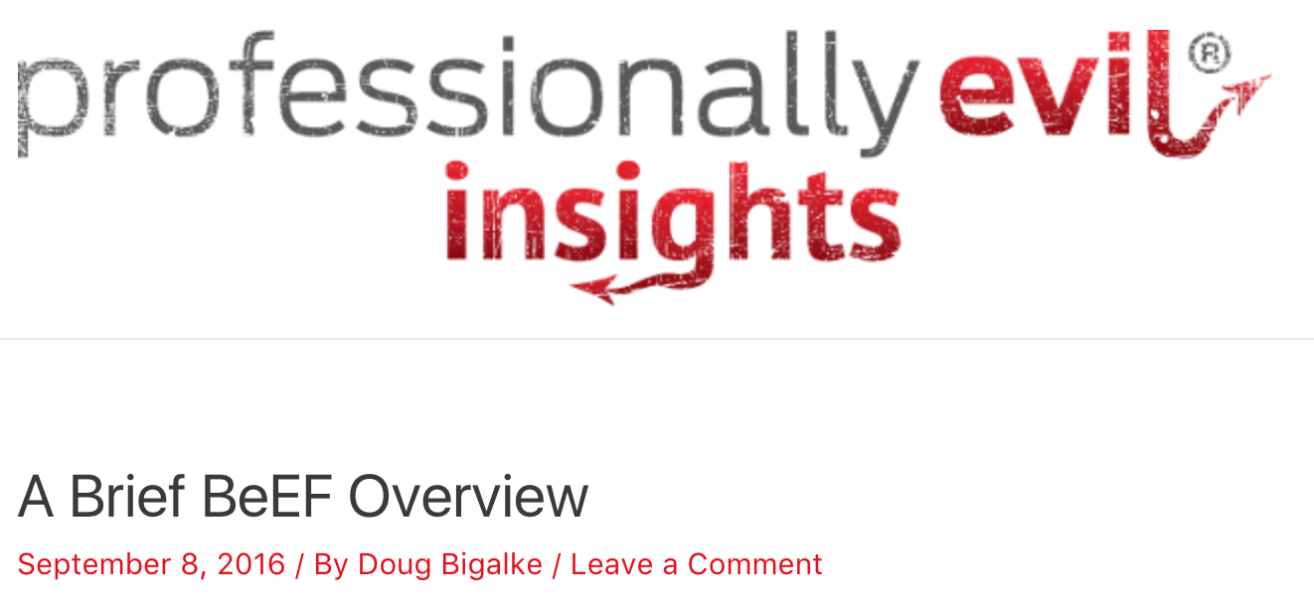
Browser Exploitation Framework
https://blog.secureideas.com/2016/09/a-brief-beef-overview.html

Slide 41
Web Application Security
Putting all of this together:
Using Server Side Discovery tactics, we can audit a web application to discover what files and references it uses in order to provide its capabilities to the end user.
Because of the increased usage of Web 2.0 technologies and an expectation to have more dynamic web applications provisioned to users, an increase in Client Side application code will occur that can be taken advantage of.
By taking advantage of a weak web application or a social engineering attack, we can direct users to our BeEF servers and perform a browser based attack

Slide 42
Attacking web applications
SQL Injection
- Act of entering SQL statements into a web-form to perform operations on the back-end database.
- Subset known as “Blind SQL Injection” is used when a vulnerable web application does not “show” the results via the website but does process the commands.
Cross Site Scripting (XSS)
- Enables an attacker to inject “client-side” scripting into a website so visitors that access the site will run the code and become infected.
- Persistent XSS is stored on the webserver itself and is served to everyone who visits the website.
- Non-persistent XSS are memory resident attacks that are formed by “dynamic” websites that do not properly validate the requests they process.

Slide 43
Web Attacks
Non-Persistent XSS Example:
A banking website
An attacker crafts a URL to exploit the vulnerability, and sends a victim an email, enticing them to click on a link for the URL under false pretenses.
This URL will point to the legitimate website but will contain malicious code, which the website will reflect.
The user visits the URL while logged into the legitimate website.
The malicious script embedded in the URL executes in the victim’s browser, as if it came directly from the legitimate
The script can be used to send the victim’s session cookie to the attacker, who can then use the session cookie to steal sensitive information available to to the victim (authentication credentials, billing info, etc.) without their knowledge.

Slide 44
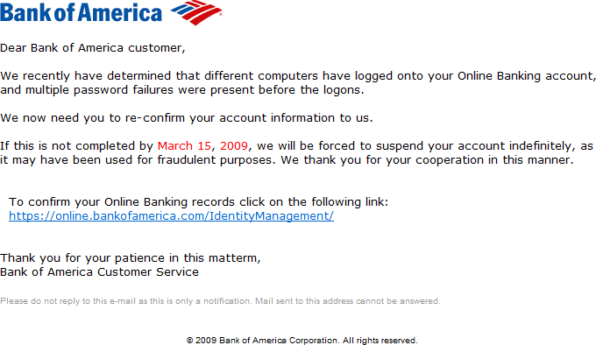
Web Attacks
Non-Persistent XSS Example:

Slide 45
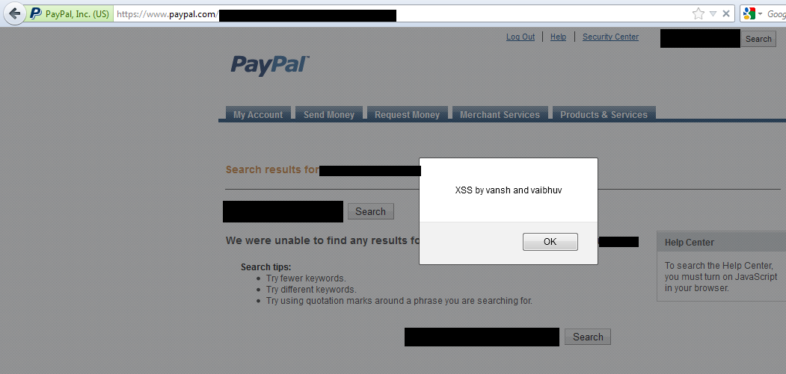
Web Attacks
Non-Persistent XSS Example:
http://thehackernews.com/2012/03/xss-vulnerability-discovered-on-paypal.html

Slide 46
Web Attacks
Persistent XSS Example:
A Social Media Site or News Site
An attacker posts a message with a malicious payload onto a comment portion of a website.
When the victim reads the news story or posting, the XSS payload steals the victim’s session cookie.
The attacker can now hijack the victim’s sessions and impersonate them.

Slide 47
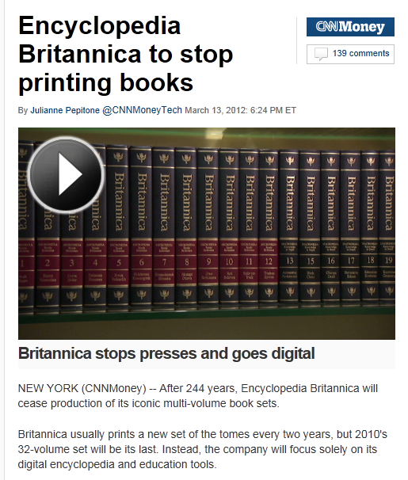
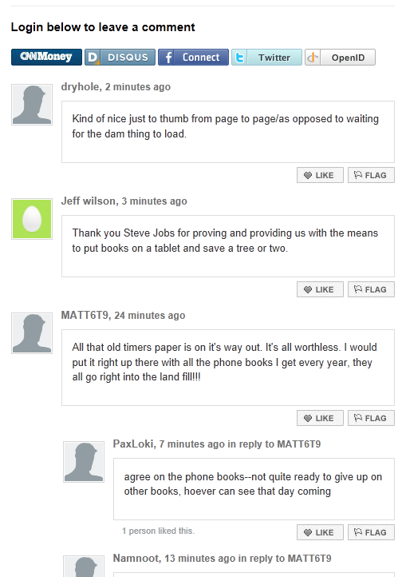
Web Attacks

Slide 48
Database Overview
Database types:
Hierarchical database management systems
Network database management systems
Relational database management systems
Object-oriented database management systems

Slide 49
Identifying SQL Servers
Popular databases and ports:
Oracle Net Listener – port 1579
Microsoft SQL – port 1433
MySQL – port 3306
SQL injection:
The attacker takes advantage of insecure code and sends his SQL statements to the database.
One of the most common attacks.

Slide 50
SQL Injection Vulnerabilities and Hacking Tools
Simple SQL injection
Nonvalidated input
Poor coding practices
UNION SQL injection
Uses the UNION command
Error-based SQL injection
Uses poorly constructed SQL statement to get error messages and table names
Blind SQL injection
Unpatched systems
Tools:
SQLDict
SQLExec
SQLbf
BSQL Hacker
SQL2.exe

Slide 51
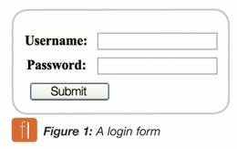
Web Attacks
Understanding SQL
SELECT username, password
FROM Users_Table
WHERE username = ‘$username’ AND password = ‘$password’;
IF (Found one record) THEN (allow user to login, provide cookie, etc)

Slide 52
Web Attacks
Understanding SQL
SELECT username, password
FROM Users_Table
WHERE username = ‘$username’ AND password = ‘$password’
OR ‘1’=‘1’;
IF (Found one record) THEN (allow user to login, provide cookie, etc)

Slide 53
Web Attacks
Understanding SQL
SELECT username, password
FROM Users_Table
WHERE username = ‘$username’ AND password = ‘$password’
OR ‘1’=‘1’; SELECT * from Users_Table; DROP table Users_Table;
IF (Found one record) THEN (allow user to login, provide cookie, etc)

Slide 54
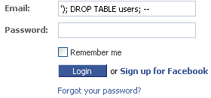
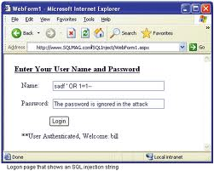
Web Attacks

Slide 55
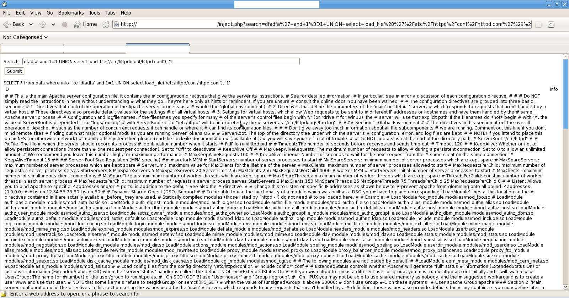
Web Attacks

Slide 56
Perspectives
Attacker Perspective
1. Exploit applications vulnerable to XSS or SQL Injection to cause damage to target databases, or steal customer data
…LEARN… ATTACK!!!!!!

Slide 57
Perspectives
Defender Perspective
1. Perform additional security testing of delivered applications prior to putting them online
2. Find security holes within websites or web forms prior to attackers
…VERIFY…

Slide 58
Perspectives
Investigator Perspective
1. Review logs for failed SQL statements
2. Review web server logs for repeated iterations of URL parameter manipulation
3. Review web server logs for SQL errors being passed in responses
…COMPARE…

Slide 59
Summary
The Web, Web 2.0
Web Servers
Pure, Hybrid, Application, Proxy
HTTP Protocol
Request/Response
Response Codes
SSL/TLS
Web Application Scanning (Server Side Discovery)
Burp Suite
Client Side Discovery
BeEF
Attack Types
XSS
Persistent
Non-Persistent
SQL Injection
Blind SQL Injection

Slide 60
Summary
Explain web architecture.
Know the tools used to scan web servers.
Explain how to perform banner grabbing and enumeration.
Identify web servers vulnerabilities.
Describe attacks against web servers.
Describe common authentication types.
Describe databases and SQL injection attacks.

Slide 61
Lab

